Slide 1
Use Case Diagrams (UCD)
A list of actions, event steps or use cases typically defining the interactions between an actor and a system to achieve a goal.
Notes prepared by G Khan

Slide 2
Symbols and their purpose

Slide 3
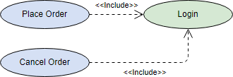
Structured use cases
<<include>> Use Case
The time to use the <<include>> relationship is after you have completed the first cut description of all your main Use Cases. You can now look at the Use Cases and identify common sequences of user-system interaction.

Slide 4

Structured use cases cont.
<<extend>> Use Case
An extending use case is, effectively, an alternate course of the base use case. The <<extend>> use case accomplishes this by conceptually inserting additional action sequences into the base use-case sequence.

Slide 5
Symbols cont
Notes:
Adapted from https://online.visual-paradigm.com/diagrams/tutorials/use-case-diagram-tutorial/

Slide 6
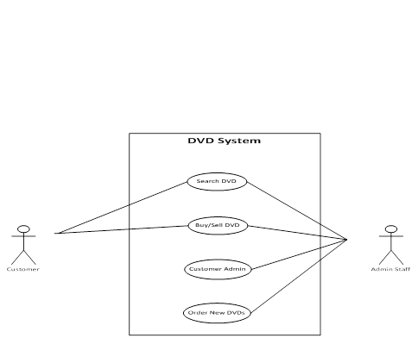
Example from a past paper
Notes:
N.B Marks would be allocated for the following elements – actors, use cases, correct relationships and notation (lines not crossing), the system name and boundary.

